Slide 1
Seeds and Fruits
Types of Dispersal

Slide 2
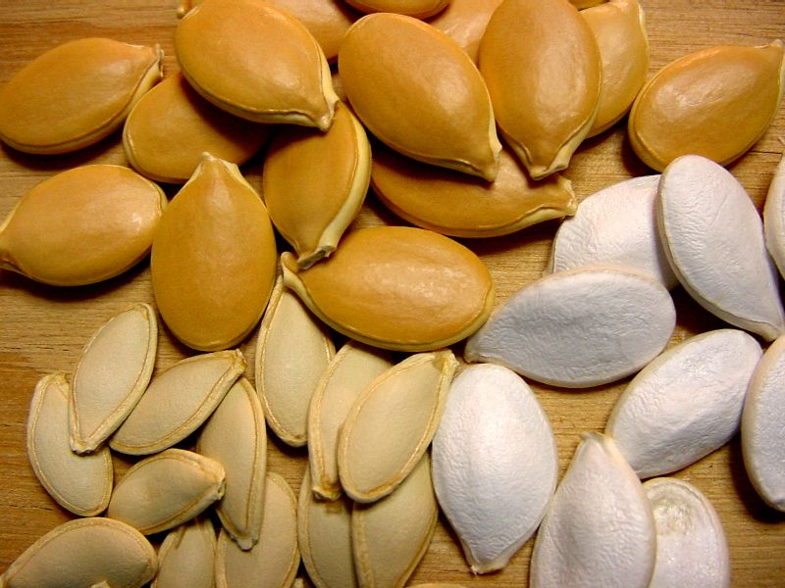
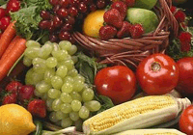
Seeds and Fruit
Fruits are formed by seed plants to aid in dispersing seeds
A seed contains the developing plant embryo in a protective coat (testa)
Seeds form from ovules fertilized in the ovary
Ovaries with seeds ripen into dry or fleshy fruits

Slide 3
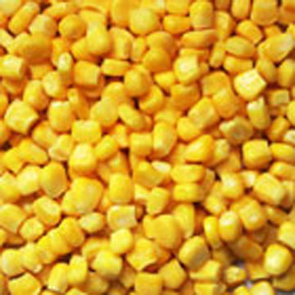
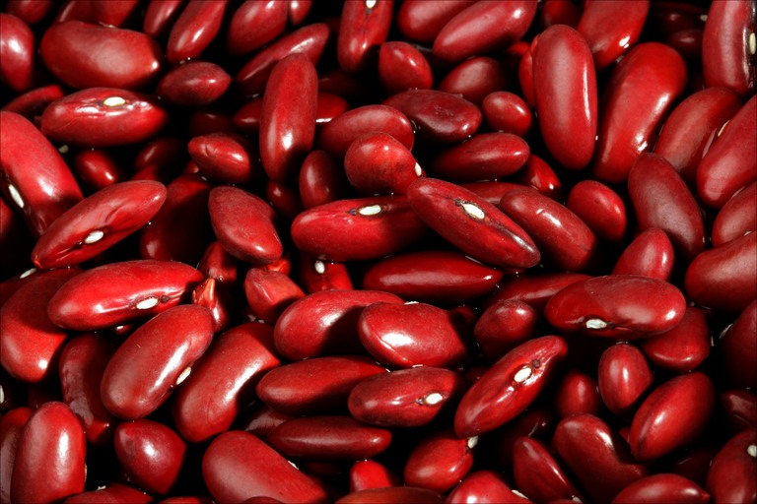
Parts of a Seed
External seed coat or testa
Developing plant embryo
Stored food called endosperm
Seeds may be in one part (monocot) or two parts (dicots)
DICOT
MONOCOT

Slide 4
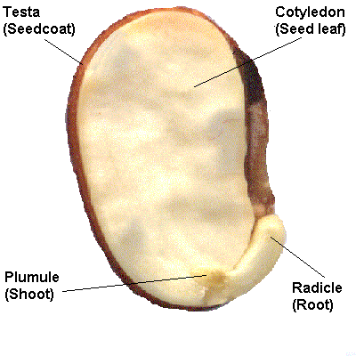
Parts of a Seed

Slide 5
What is the purpose of the fruit?
The main function of the fruit is to disperse the seeds
Dispersal is important because
1. It spreads the progeny in order to colonize new environments
2. Reduces competition for resources with parents
3. Reduces the chances of predators destroying all of the plant’s yearly seed production
Four types of seed dispersal:
A. Self dispersal
B. Wind dispersal
C. Water dispersal
D. Animal dispersal

Slide 6
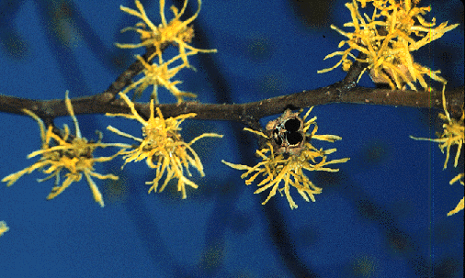
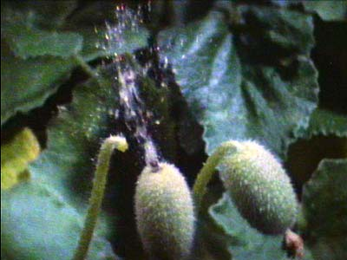
Self dispersal
Plants disperse their seeds by ejection explosive fruits!
squirting cucumber (jet propulsion)
Poppy head

Slide 7
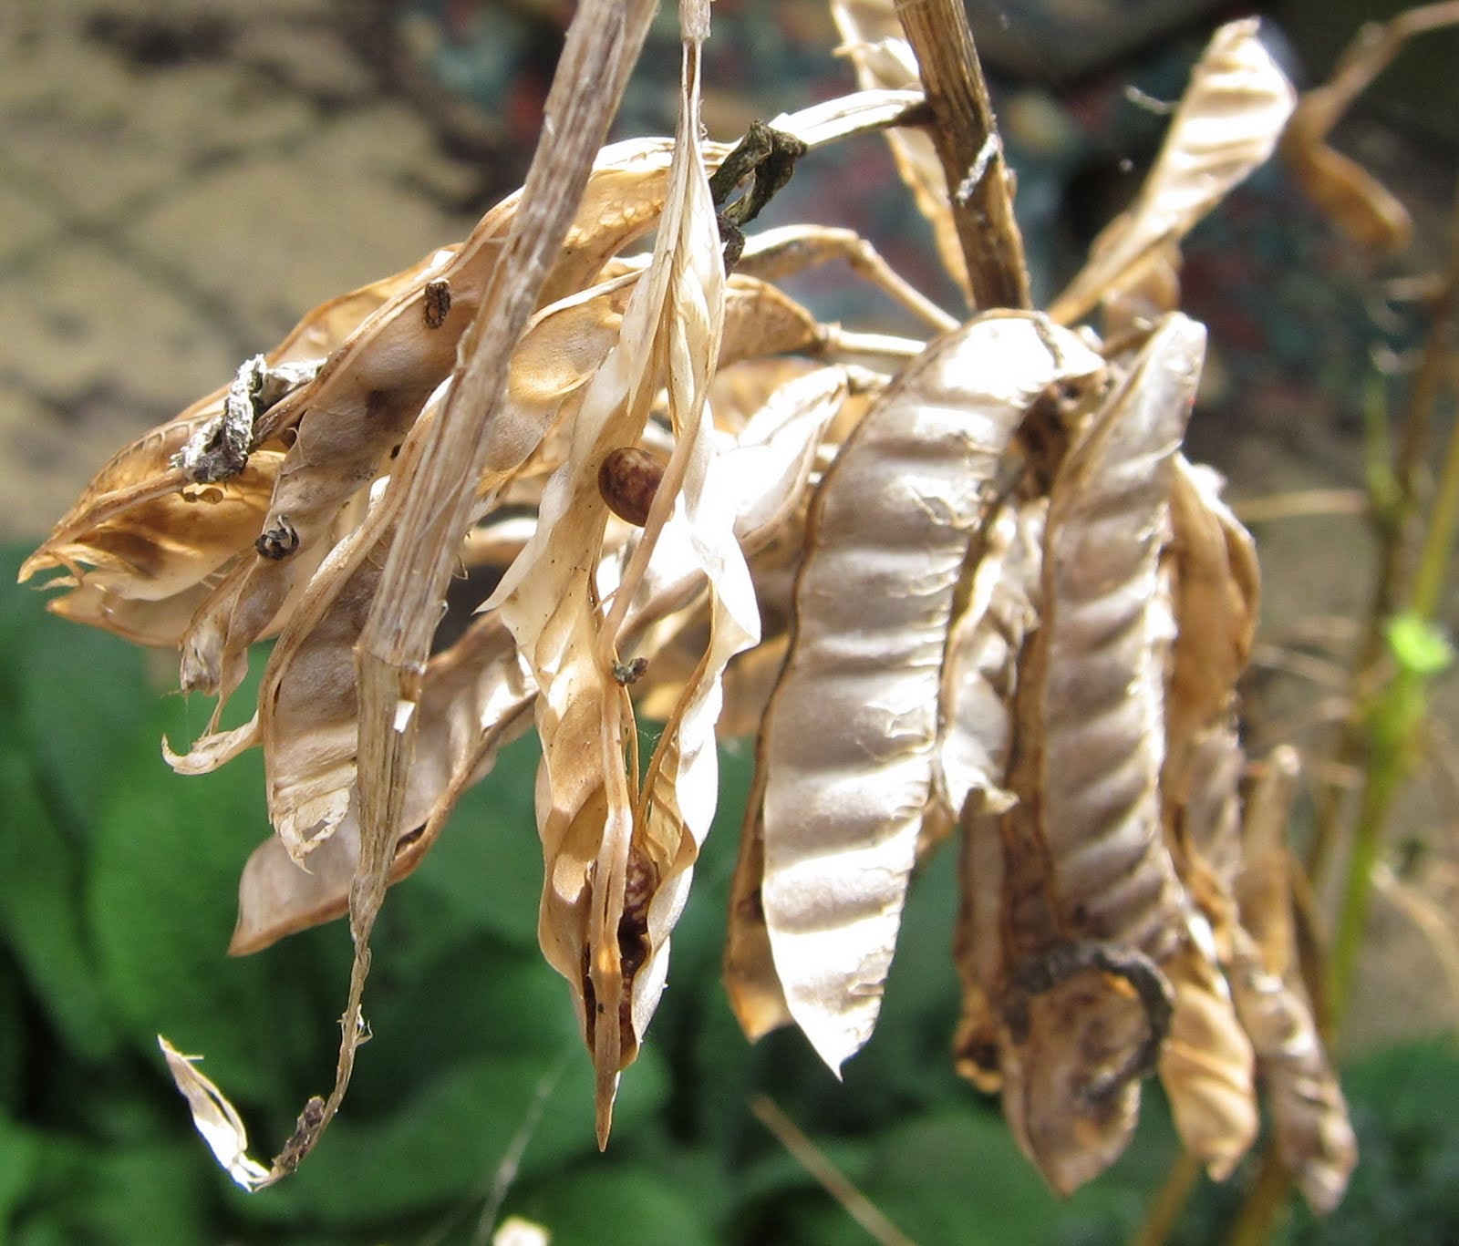
Lupins pod can catapult the seed
copyright cmassengale

Slide 8
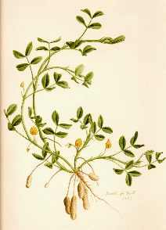
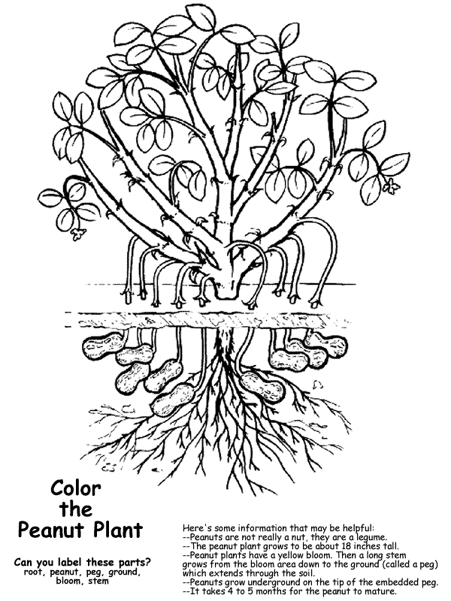
Self dispersal
The peanut plant
Geocarpic: carpel grows
inside the earth (soil)

Slide 9

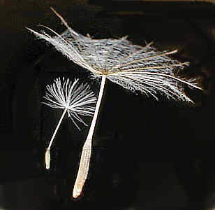

Wind dispersal
Fruit and seeds may have special devices for wind dispersal
Plumes catch wind currents: Dandelion like parachute of fine hair
Trees take advantage of their great heights for wind dispersal. Fruits with wings are used to slow the descent to land: maple, ash , sycamore fruit

Slide 10
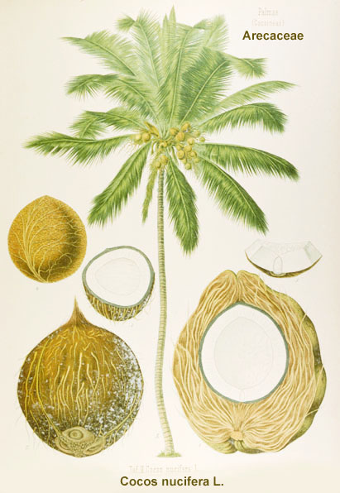
Water Dispersal
Fruits and/or seeds use flotation devices to travel by water (in rivers, oceans, etc.)
Fruit may have air spaces and corky floats: for example coconuts palms – tropical island

Slide 11
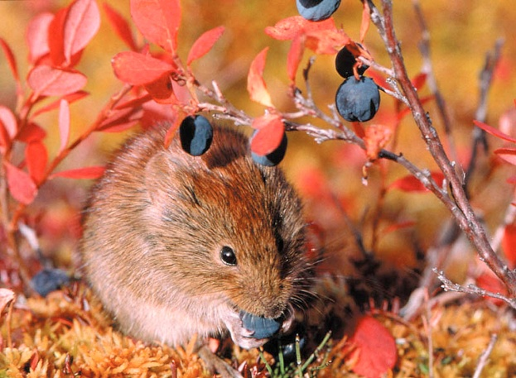
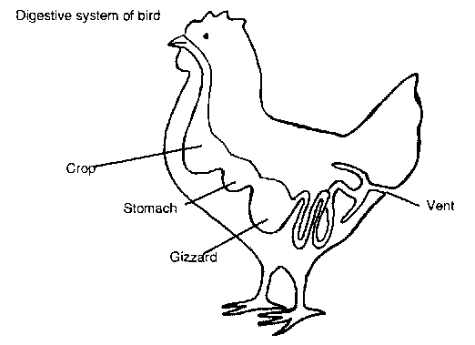
Animal dispersal
Many plants depend on animals for seed dispersal; they may offer a nutritional reward
Animals learn to recognize ripened fruit colors
Fleshy fruits eaten and dispersed
with feces: like hawthorn eaten by birds

Slide 12
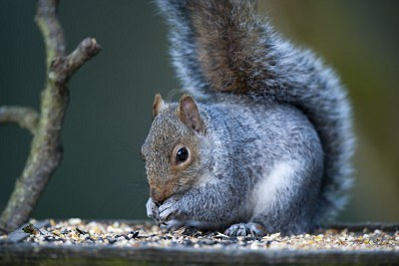
Squirrels burying the seeds in the ground and the seeds germinate before squirrel find them again

Slide 13
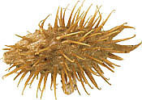
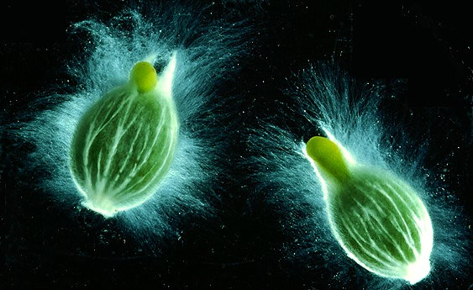
Animal dispersal
Some dry fruit attach and cling to animals
(they hitchhike on the animals) such as cleavers
Some have Velcro-like hooks that cling to animal fur (burdock, cockleburs)
Others have sticky substances that stick to host (mistletoe)

Slide 14
